Slide 1
Intro to Arduino Programming
Lesson 15

Slide 2
Outline
Arduino (ATMEGA328 µcontroller)
IDE
Importing Libraries
Lab 6 Prelab

Slide 3
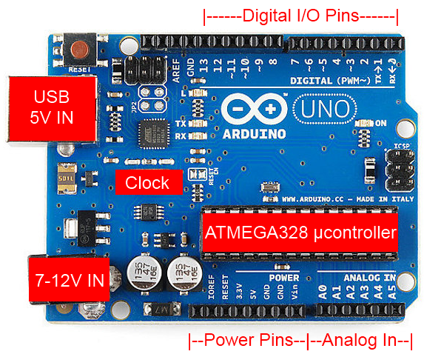
Arduino (ATMEGA328 µcontroller)
No operating system
Directly interacts with external devices
Real-time processor
Add-ons called shields
Arduino IDE using a flavor of C called Arduino

Slide 4
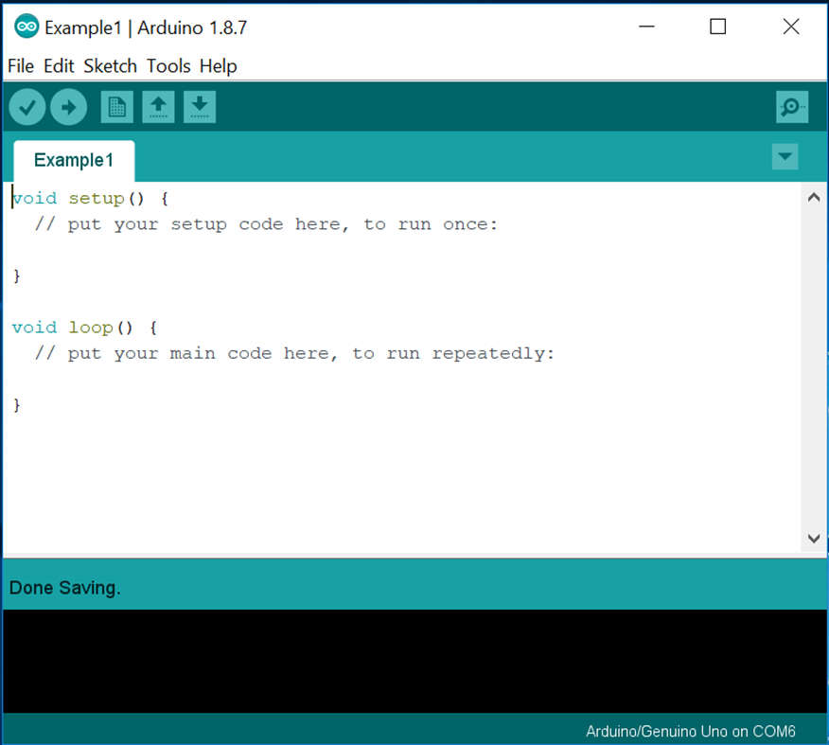
IDE (Integrated Development Environment)

Slide 5
Arduino Sketch

Slide 6
Messages/Errors

Slide 7
Verify/Upload/New/Open/Save

Slide 8
Menus

Slide 9
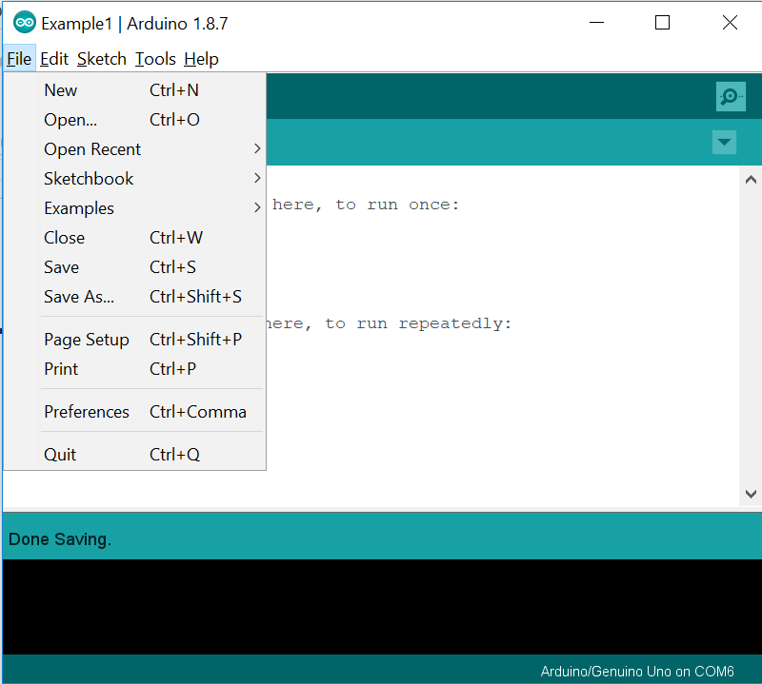
Menus

Slide 10
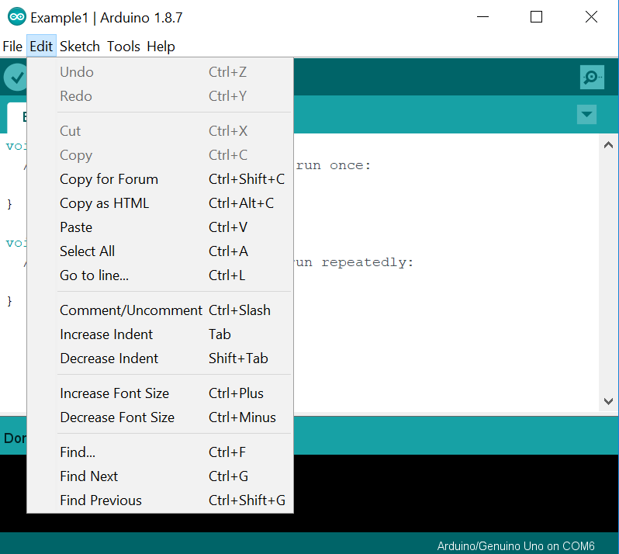
Menus

Slide 11
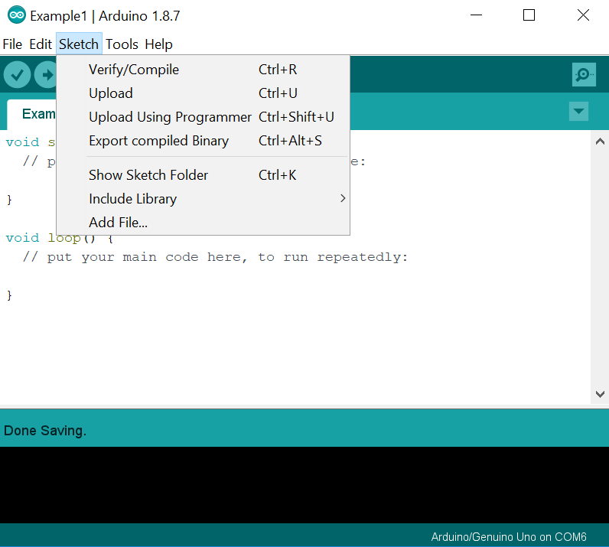
Menus

Slide 12
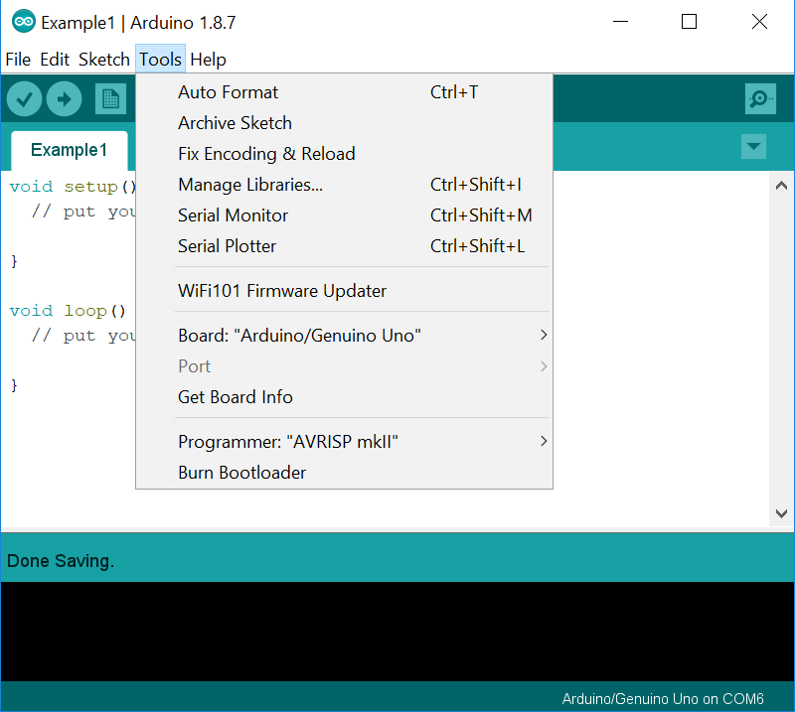
Menus

Slide 13
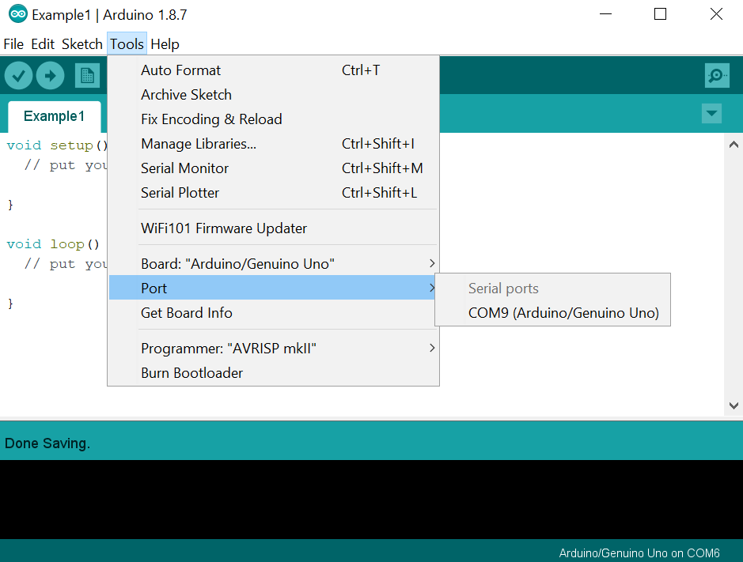
Menus

Slide 14
Common Types of Variables
Boolean – true or false
char – takes one byte of memory to store character
byte – 8-bit unsigned number from 0 to 255
int – 16-bit value from -32,768 to 32,767
long – 32-bit value
float – number that has a decimal point
array – list of values
Strings- stored as a char array or String object
Local variables vs Global variables

Slide 15
Arrays, Conditions, Loops and, Serial
Array
A list used to store and retrieve values
Control Statements
If something is true, do something
Loops
Do something repeatedly as long as a condition is true
Serial
Part of the standard Arduino library, allows us to send values to the serial port
Often will observe values coming from the Arduino using the serial monitor

Slide 16
First Arduino Program
Set LED on Arduino (Pin 13) to blink on and off every second

Slide 17
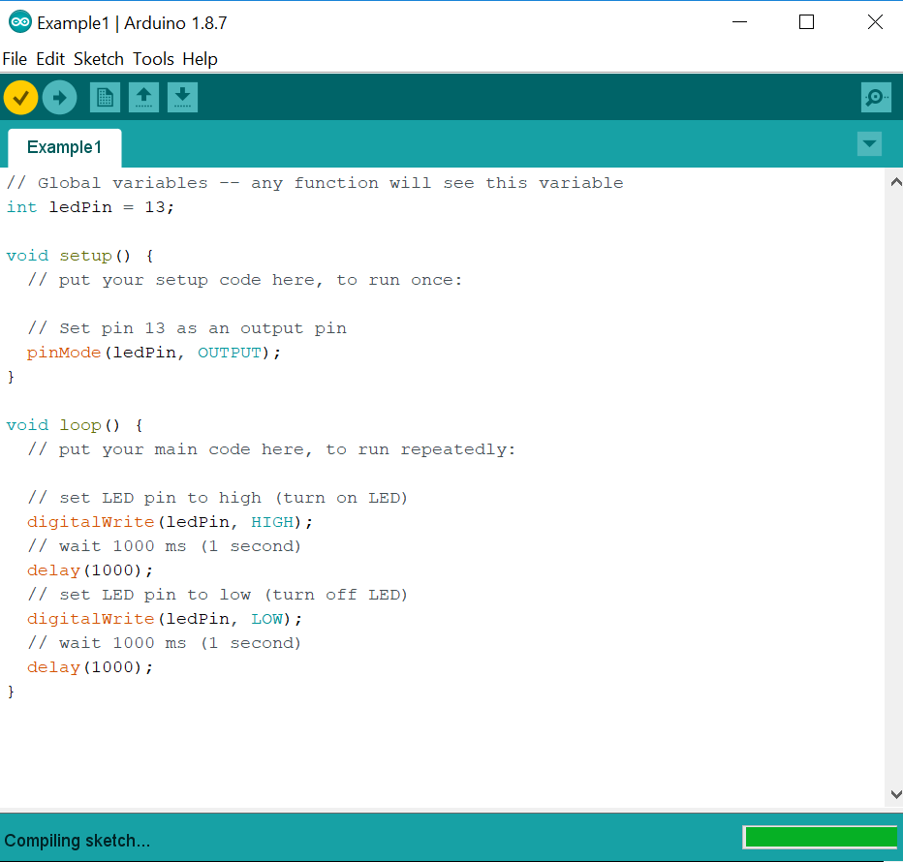

Slide 18
Second Arduino Program
Create two arrays, both with a size of 5, one empty, the other holding the values 1-5
Copy the values from the filled array to the empty array
Print the values in the arrays
Change the value at index 1 to 12
Open serial monitor to make sure Arduino is sending correct values

Slide 19
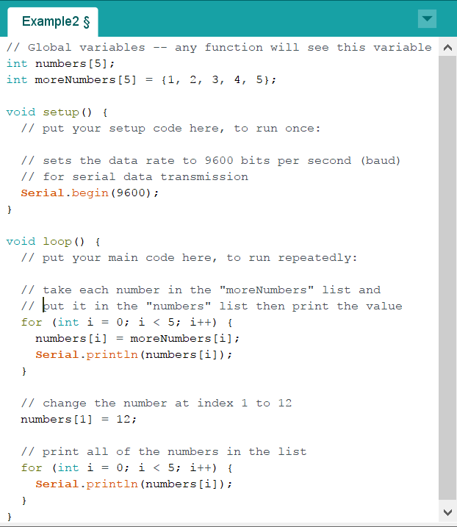

Slide 20
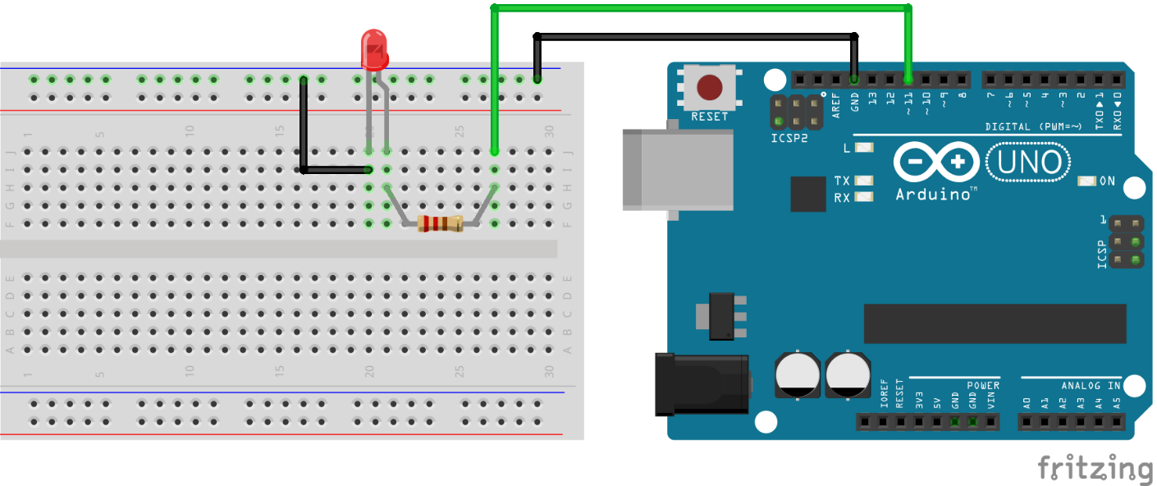
Third Arduino Program
Build the below circuit using a 330 Ω resistor
Create code to pulse the LED on and off

Slide 21
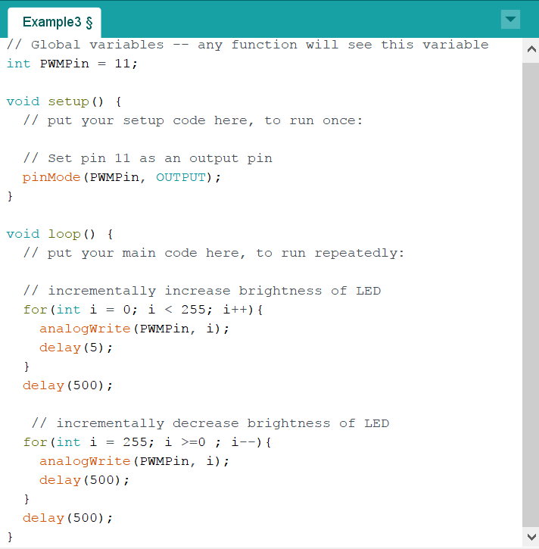

Slide 22
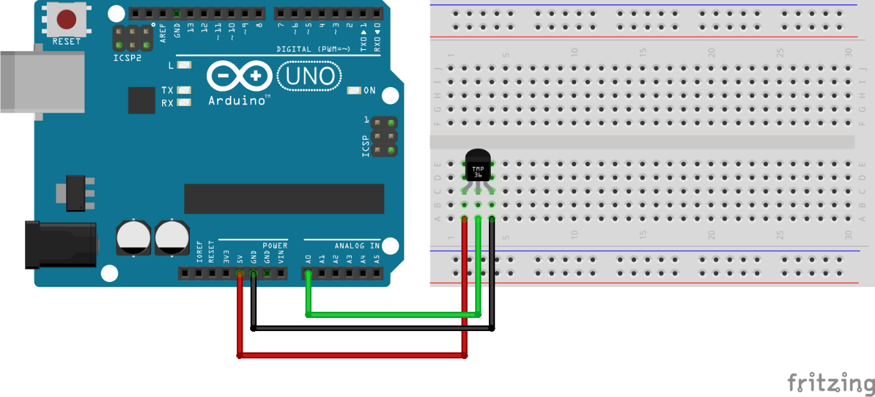
Fourth Arduino Program
Build the below circuit using a TMP36 sensor
Create code to read the temperature and display using the Serial Monitor

Slide 23
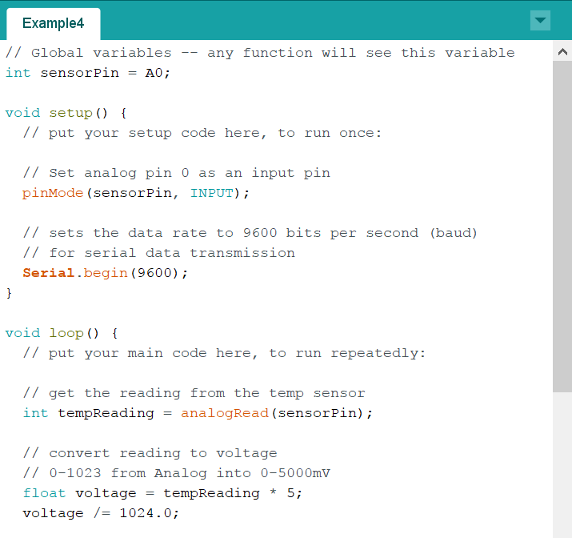

Slide 24
